Slide 1
UNIT IV Parallelism

Slide 2
Contents
Parallelism
Need for parallelism
Types of Parallelism
Applications of Parallelism
Parallelism in Software
Instruction level parallelism
Data level parallelism
Challenges in Parallelism
Architecture of Parallel system
Flynn’s Classification
SISD , SIMD
MIMD, MIMD
Hardware Multi threading
Coarse grain Parallelism
Fine grain Parallelism
Uni-Processor and MultiProcessor
Muti-core Processor
Memory in multi-processor system
Cache Coherency in multi-processor system
MESI Protocol for multi-processor system

Slide 3
Parallelism
Executing two or more operations at the same time is known as parallelism.
Parallel processing is a method to improve computer system performance by executing two or more instructions simultaneously
A parallel computer is a set of processors that are able to work cooperatively to solve a computational problem.
Examples:
Two or more ALUs in CPU can work concurrently to increase throughput
The system may have two or more processors operating concurrently

Slide 4
Goals of parallelism
To increase the computational speed: to reduce the amount of real time that you need to wait for a problem to be solved
To increase throughput: the amount of processing that can be accomplished during a given interval of time
To improve the performance of the computer for a given clock speed.
To solve bigger problems that might not fit in the limited memory of a single CPU

Slide 5
Applications of Parallelism
Numeric weather prediction
Socio economics
Finite element analysis
Artificial intelligence and automation
Genetic engineering
Weapon research and defense
Medical Applications
Remote sensing applications

Slide 6
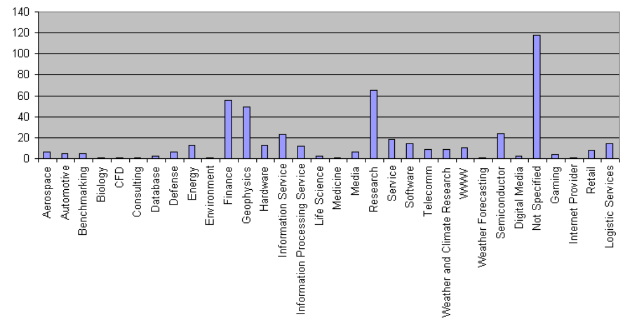
Applications of Parallelism

Slide 7
Types of parallelism
Hardware Parallelism
2. Software Parallelism
Hardware Parallelism :
machine architecture and hardware multiplicity.
Increase the number of instruction issues per machine cycle.
k-issue processor: processor issues k instructions per machine cycle

Slide 8
Software Parallelism
It is defined by the control and data dependence of programs.
The degree of parallelism is revealed in the program profile or in the program flow graph.
Software parallelism is a function of algorithm, programming style, and compiler optimization.
The program flow graph displays the patterns of simultaneously executable operations.
Parallelism in a program varies during the execution period .
It limits the sustained performance of the processor.

Slide 9
Example
Example:
A=L1*L2+L3*L4
B=L1*L2-L3*L4
Software Parallelism:
There are 8 instructions
FOUR Load instructions(L1,L2,L3&L4).
TWO Multiply instructions(X1&X2)
ONE Add instruction(+)
ONE Subtract instruction()•
The parallelism varies from 4 to 2 in three cycles.

Slide 10
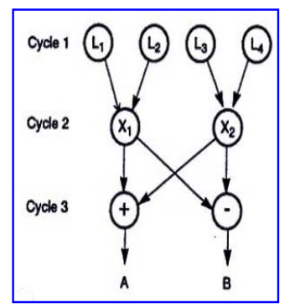


Slide 11
Hardware Parallelism - example
Using TWO-issue processor:
The processor can execute one memory access(Load/Store) and one arithmetic operation(multiply, add, subtract) simultaneously.
The program must execute in 7 cycles.
The h/w parallelism average is 8/7=1.14.
It is clear from this example that there is a mismatch between the s/w and h/w parallelism.

Slide 12
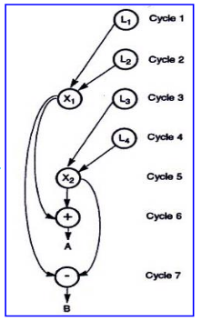

Slide 13
Parallelism vs pipelining
Parallelism:
Execute several instructions / clock cycle.
More performance.
Pipelining:
Push only one instruction to next stage / clock cycle.
multiple instructions are overlapped in an execution. Relatively low performance.

Slide 14
Software Parallelism - types
Parallelism in Software
Instruction level parallelism
Task-level parallelism
Data parallelism
Transaction level parallelism

Slide 15
Instruction level parallelism (ILP)
It is a measure of how many operations can be performed in parallel at the same time in a computer program.
Increases depth of pipeline.
ILP allows the compiler and processor to overlap the execution of multiple instructions or even to change the order in which instructions are executed.
Replicate internal components to process multiple instructions at every clock cycle (Multiple issue).

Slide 16
MULTIPLE ISSUE PROCESSOR
More than one instruction is pushed into the pipeline
Types:
Static multiple issue: scheduling is done at compile time.
Dynamic multiple issue: scheduling is done at execution time.
Challenges:
Data hazards
Usage of free slots

Slide 17
Eg. Instruction level parallelism
Consider the following example
1. x= a+b
2. y=c-d
3. z=x * y
Operation depends on the results of 1 & 2
So ‘Z ‘ cannot be calculated until X & Y are calculated
But 1 & 2 do not depend on any other. So they can be computed simultaneously.

Slide 18
If we assume that each operation can be completed in one unit of time then these 3 operations can be completed in 2 units of time .
ILP factor is 3/2=1.5 which is greater than without ILP.
A superscalar CPU architecture implements ILP inside a single processor which allows faster CPU throughput at the same clock rate.

Slide 19
Data-level parallelism (DLP)
Data parallelism is parallelization across multiple processors in parallel computing environments.
It focuses on distributing the data across different nodes, which operate on the data in parallel.
Instructions from a single stream operate concurrently on several data
Limited by non-regular data manipulation patterns and by memory bandwidth

Slide 20
DLP - example
Let us assume we want to sum all the elements of the given array of size n and the time for a single addition operation is Ta time units.
In the case of sequential execution, the time taken by the process will be n*Ta time unit
if we execute this job as a data parallel job on 4 processors the time taken would reduce to (n/4)*Ta + merging overhead time units.

Slide 21
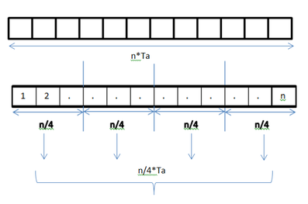
DLP in Adding elements of array

Slide 22
Locality of Reference
The locality of data references plays an important part in evaluating the performance of a data parallel programming model.
Locality of data depends on the memory accesses performed by the program as well as the size of the cache.
Locality of Reference refers to the tendency of the computer program to access instructions whose addresses are near one another.

Slide 23
CHALLENGES IN PARALLEL PROCESSING
Parallel processing programs must yield better performance than the sequential programs.
Innovation of new architectures demands rewriting of the parallel programs.
Modern processors are very fast so that even the sequential programs yields equally better performance to parallel programs.
When a single program is run on multiple processors, few processors may need to wait for the other processors to complete their tasks. This waiting is because these processors have to operate on the finished data of the previous processors.
The parallel processing programs have communication overhead.

Slide 24
ARCHITECTURE OF PARALLEL SYSTEMS: Flynn’s Classification
Was proposed by researcher Michael J. Flynn in 1966.
It is the most commonly accepted taxonomy of computer organization.
Flynn's taxonomy is a specific classification of parallel computer architectures that are based on the number of concurrent instruction (single or multiple) and data streams (single or multiple) available in the architecture.
Criteria:
processes a single or multiple instruction at a time
operates on one or multiple data sets.

Slide 25
Flynn’s Classification
Two independent dimensions: Instruction stream and Data stream.
Instruction stream: sequence of instructions executed by machine.
Data stream: sequence of data including input, partial or temporary results used by instruction stream.
Two possible states: Single or Multiple.
Flynn’s classification depends on the distinction between the performance of control unit and the data processing unit rather than its operational and structural interconnections.

Slide 26
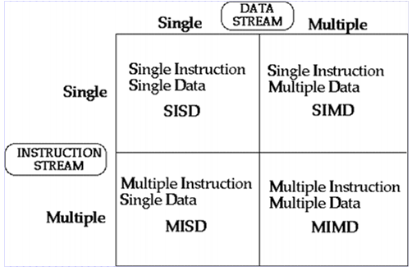
Flynn’s Classification
Four category of Flynn classification

Slide 27
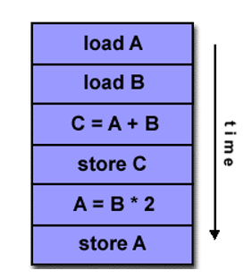

SISD
They are also called scalar processor i.e., one instruction at a time and each instruction have only one set of operands.
Single instruction: only one instruction stream is being acted on by the CPU during any one clock cycle.
Single data: only one data stream is being used as input during any one clock cycle.
Deterministic execution.
Instructions are executed sequentially.
SISD computer having one control unit, one processor unit and single memory unit.

Slide 28
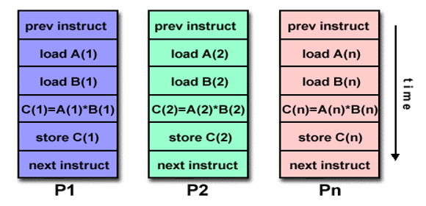
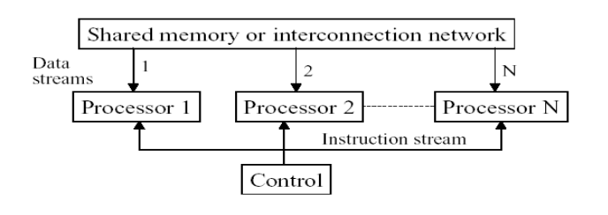
SIMD
A type of parallel computer.
Single instruction: All processing units execute the same instruction issued by the control unit at any given clock cycle .
Multiple data: Each processing unit can operate on a different data element. The processor are connected to shared memory or interconnection network providing multiple data to processing unit
single instruction is executed by different processing unit on different set of data

Slide 29
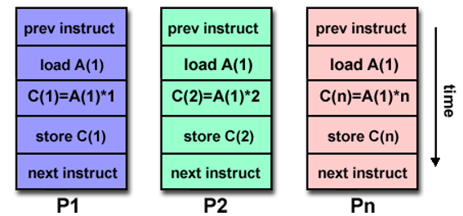
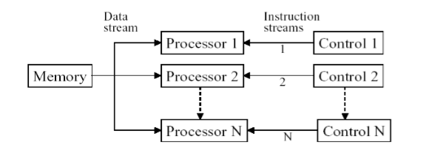
MISD
A single data stream is fed into multiple processing units.
Each processing unit operates on the data independently via independent instruction.
A single data stream is forwarded to different processing unit which are connected to different control unit and execute instruction given to it by control unit to which it is attached.
same data flow through a linear array of processors executing different instruction streams

Slide 30
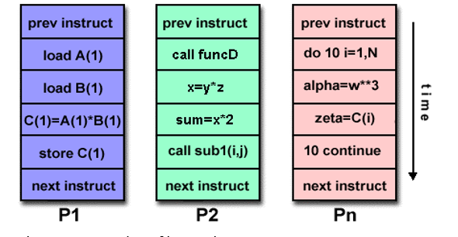
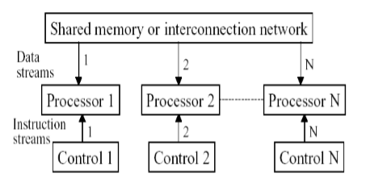
MIMD
Multiple Instruction: every processor may be executing a different instruction stream.
Multiple Data: every processor may be working with a different data stream.
Execution can be synchronous or asynchronous, deterministic or nondeterministic
Different processor each processing different task.

Slide 31
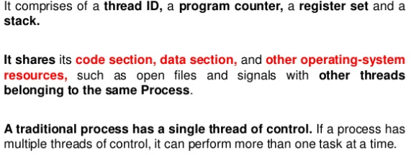
Thread
A thread is a basic unit of CPU utilization, consisting of a program counter, a stack, and a set of registers, ( and a thread ID. )
Traditional ( heavyweight ) processes have a single thread of control - There is one program counter, and one sequence of instructions that can be carried out at any given time.
Multiple threads can exist within one process, executing concurrently and sharing resources such as memory, while different processes do not share these resources.
Multithreading is a type of execution model that allows multiple threads to exist within the context of a process such that they execute independently but share their process resources.
A thread maintains a list of information relevant to its execution including the priority schedule, exception handlers, a set of CPU registers, and stack state in the address space of its hosting process.

Slide 32
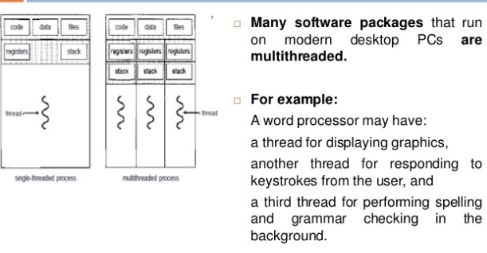
Example for Multithread

Slide 33
Multithreading
Multithreading is the ability of a central processing unit (CPU) (or a single core in a multi-core processor) to provide multiple threads of execution concurrently, supported by the operating system.
In a multithreaded application, the threads share the resources of a single or multiple cores, which include the computing units, the CPU caches, and the translation lookaside buffer (TLB).
Where multiprocessing systems include multiple complete processing units in one or more cores
Multithreading aims to increase utilization of a single core by using thread-level parallelism, as well as instruction-level parallelism.

Slide 34
Hardware Multithreading
Multiple threads share the functional units of a single processor in an overlapping fashion
Utilize the hardware resources efficiently.
Implemented by duplicating the independent state of each thread.
Example: each thread would have a separate copy of register file and program counter.
Hardware must support to change to a different thread relatively quickly.
Thread switch should be much more efficient.
Types: Fine grained and Coarse grained
Granularity: amount of work done by the thread.

Slide 35
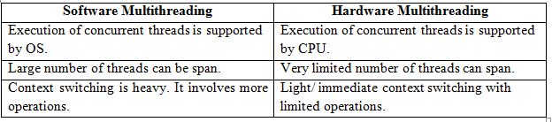
HARDWARE VS SOFTWARE MULTITHREADING

Slide 36
Fine grained multi threading
Switches between threads on each instruction, resulting in interleaved execution of multiple threads.
CPU switch to another thread at every cycle such that no two instructions from the thread are in the pipeline at the same time- interleaved multithreading.
This is done in a round-robin fashion.
Skips threads that are stalled at that clock cycle.
Processor must be able to switch threads on every clock cycle.
Advantages:
No need for dependency checking between instructions since only one instruction in pipeline from a single thread.
No need for branch prediction logic.
The stalls used for executing useful instructions from different threads.
Improved system throughput, latency tolerance, utilization.

Slide 37
Fine grained multi threading
Disadvantages:
Extra hardware complexity because of implementation of multiple hardware contexts and thread selection logic.
Reduced single thread performance as one instruction fetched every N cycles.
Resource contention between threads in caches and memory.
Dependency checking logic between threads remains.

Slide 38
Coarse grained multi threading
Here, the switch only happens when the thread in execution causes a stall, thus wasting a clock cycle.
The instructions of threads are executed successively until an event in current execution thread cause latency. This delay event induces a context switch.
When a thread is stalled due to some event, the CPU switch to a different hardware context: Switch-on-event multithreading or blocked multithreading.
This change relieves need to have thread switching be extremely fast.
Improves the execution of an individual thread, since instructions from or threads will only be issued when a thread encounters a costly stall.
Causes for latency or stalls: Cache misses, Synchronization events and floating point operations.
Advantages:
Simpler to implement, can eliminate dependency checking and branch prediction logic completely
Switching need not have any performance overhead.
Higher performance overhead with deep pipelines and large windows
Disadvantages
Limited ability to overcome throughput losses, especially from shorter stalls.

Slide 39
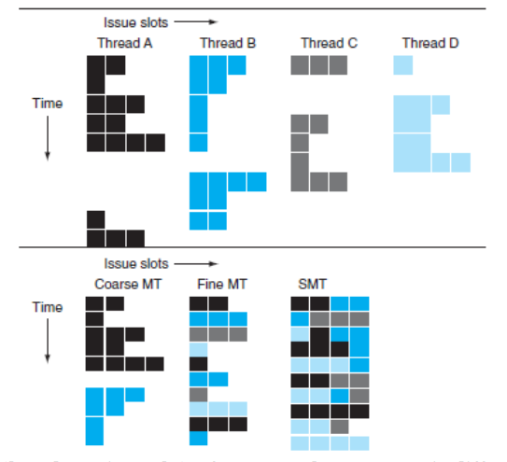
Comparison

Slide 40
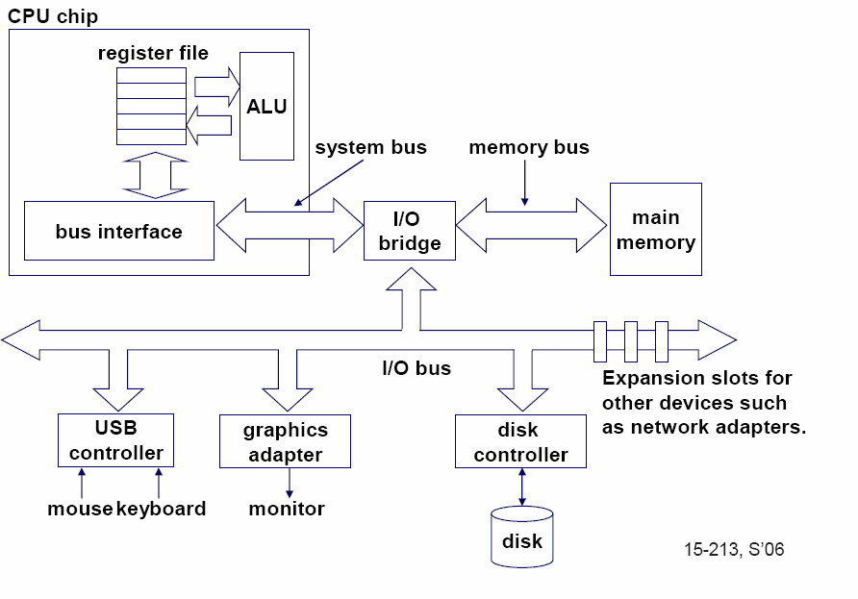
Single-core computer
40

Slide 41
MULTICORE PROCESSOR
It is a single computing component with two or more independent processing units called cores, which read and execute program instructions.
Single physical processor contains the core logic of two or more processors.
Multiprocessor systems: Separate CPU for processing
Multicore processor: Same processor has multiple cores.
Need for Multicore processors
Increasing the frequency of single-core processors are difficult.
The deeply pipelined circuits faces: heat problems, difficult design and verification, large design teams are necessary, server farms need expensive air-conditioning.
Many new applications are multithreaded.
General trend in computer architecture shifts towards more parallelism.

Slide 42
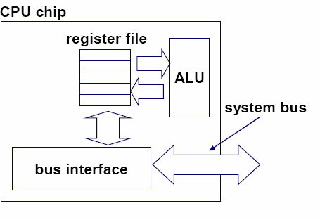
Single-core CPU chip
the single core
42

Slide 43
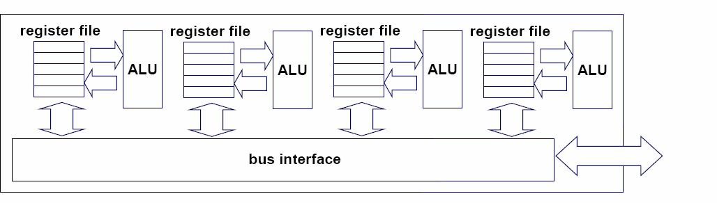
Multi-core architectures
Replicate multiple processor cores on a single die.
Core 1 Core 2 Core 3 Core 4
Multi-core CPU chip
4

Slide 44
Multi-core CPU chip
The cores fit on a single processor socket
Also called CMP (Chip Multi-Processor)
c o r e 1 | c o r e 2 | c o r e 3 | c o r e 4

Slide 45
The cores run in parallel
thread 1 thread 2 thread 3 thread 4
c
c
c
c
o
o
o
o
r e
r e
r e
r e
1
2
3
4

Slide 46
Within each core, threads are time-sliced (just like on a uniprocessor)
several threads
several threads
several threads
several threads
c
c
c
c
o
o
o
o
r e
r e
r e
r e
1
2
3
4

Slide 47
Challenges in multicore processors
Trade- off and balance between instruction-level parallelism and thread-level parallelism.
Shared resource management (functional units, caches)
Multi-threading v/s Multi-core tradeoffs
On and Off-chip bandwidth requirements
Latencies (execution, cache, and memory) reduction
Memory Coherence/Consistency (for high speed on-die cache hierarchies)
Multiple domains (and crossing) in clocking, voltage etc.
Partitioning resources (between threads/cores)
Fault tolerance (at device, storage, execution, core level)
On-die interconnect (optimized along latency, bandwidth, modularity, power)
Integration (of system components, and/or fixed function devices)

Slide 48
Disadvantages of multicore processors
Power is costly; Transistors, relatively cheap
Frequency alone is not important. Efficiency in terms of Performance-per-watt is critical;
Computation is relatively easy; Memory accesses are NOT easy.
Need for scalability of OS, Data Structures and Policies
Synchronization and locking, Scheduling, Process management, Data structure sizing and management limitations, Threading granularity and primitives must be changed.
Need high Bandwidth I/O Support

Slide 49
Multicore vs Multiprocessor
Multicore processor is a special type of multiprocessor: All the cores of a multiprocessor are embedded on a single chip.
Multi-core processors are MIMD: Different cores execute different threads (Multiple Instructions), operating on different parts of memory (Multiple Data).
Multi-core is a shared memory multiprocessor (i.e) all cores share the same memory.

Slide 50
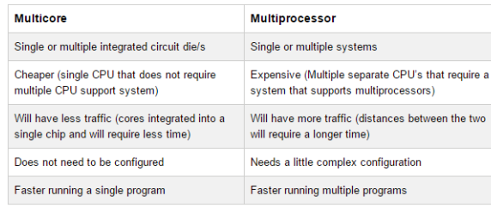
Multi core vs multiproessor

Slide 51
Memory in Multiprocessor System
Two architectures:
Shared common memory
Unshared Distributed memory.

Slide 52
Shared memory multiprocessors
All processors to access all memory as global address space.
Multiple processors can operate independently but share the same memory resources.
Changes in a memory location effected by one processor are visible to all other processors.
Shared memory machines can be divided into two main classes based upon memory access times: UMA , NUMA and COMA.

Slide 53
Uniform Memory Access (UMA)
All the processors share the physical memory in a centralized manner with equal access time to all the memory words.
Each processor / peripheral device may have a private cache memory.
Symmetric multiprocessor: all the processors have equal access to all the peripheral devices.
Asymmetric multiprocessor: only one or a few processors can access the peripheral devices.
Shared memory can quickly become a bottleneck for system performances, since all processors must synchronize on the single bus and memory access.
Cache coherent (CC): if one processor updates a location in shared memory, all the other processors know about the update. Cache coherency is accomplished at the hardware level.
CC-UMA : UMA with CC.

Slide 54
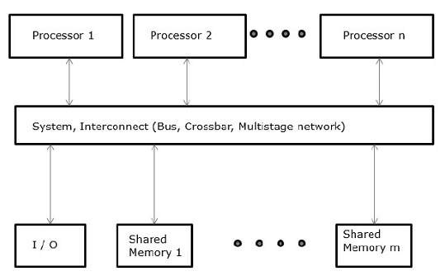
UMA

Slide 55
Non-Uniform Memory Access (NUMA)
Access time varies with the location of the memory word.
Shared memory is physically distributed among all the processors: local memories.
The collection of all local memories forms a global address space which can be accessed by all the processors: global / remote memories.
Share CPUs and the address space, but each processor has a local memory, visible to all other processors.
Access to local memory blocks is quicker than access to remote memory blocks.
Types: Non-Caching NUMA (NC-NUMA) and Cache-Coherent NUMA (CC-NUMA).

Slide 56
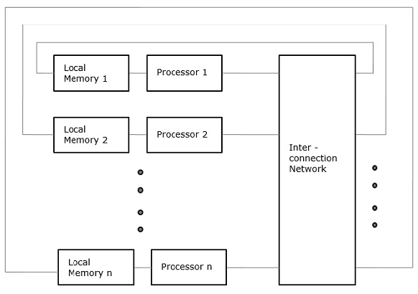
NUMA

Slide 57
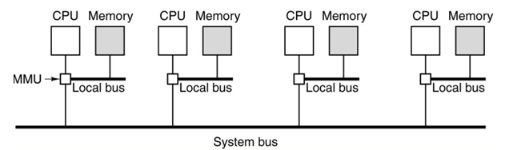
Non-Caching NUMA (NC-NUMA)
Processors have no local cache.
Each memory access is managed with a modified MMU (Memory Management Unit), which controls if the request is for a local or for a remote block.
programs using remote data will run much slower.
In NC-NUMA systems there is no cache coherency problem, because there is no caching at all: each memory item is in a single location.
Remote memory access is however very inefficient.

Slide 58
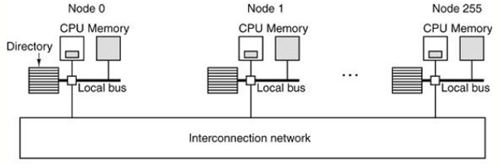
Cache-Coherent NUMA (CC-NUMA)
Associate each node in the system with a directory for its RAM blocks
Directory is a database stating in which cache is located a block, and what is its state.
When a block of memory is addressed, the directory in the node where the block is located is queried, to know if the block is in any cache and, if so, if it has been changed respect to the copy in RAM.

Slide 59
Cache Only Memory Access (COMA)
All the distributed main memories are converted to cache memories.
In COMA, there is no longer a home address, and the entire physical address space is considered a huge, single cache.
Data can migrate within the whole system, from a memory bank to another, according to the request of a specific CPU, that requires that data.

Slide 60
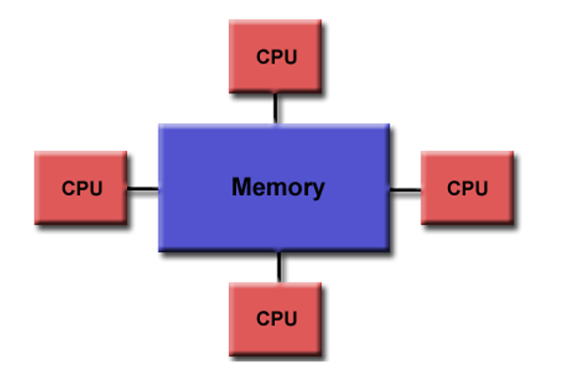
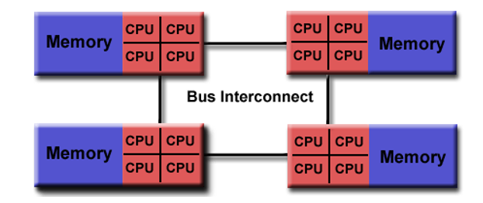
Shared Memory
Uniform Memory Access
Non-Uniform Memory Access

Slide 61
Distributed memory systems
Distributed memory systems require a communication network to connect inter-processor memory.
Processors have their own local memory.
Memory addresses in one processor do not map to another processor, so there is no concept of global address space across all processors.
Because each processor has its own local memory, it operates independently.
Changes it makes to its local memory have no effect on the memory of other processors. Hence, the concept of cache coherency does not apply.
When a processor needs access to data in another processor, it is usually the task of the programmer to explicitly define how and when data is communicated.
Synchronization between tasks is likewise the programmer's responsibility.

Slide 62
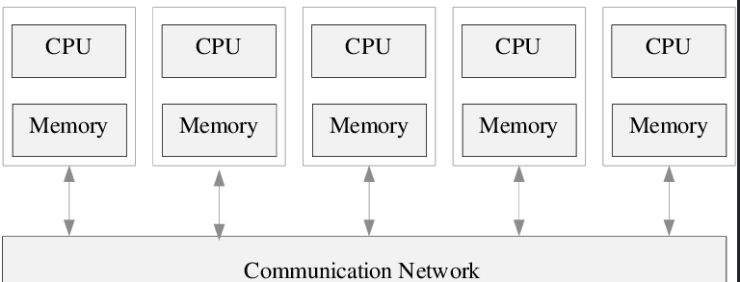
DISTRIBUTED MEMORY

Slide 63
Private vs shared caches
Advantages of private:
They are closer to core, so faster access
Reduces contention
Advantages of shared:
Threads on different cores can share the same cache data
More cache space available if a single (or a few) high-performance thread runs on the system

Slide 64
The cache coherence problem
As multiple processors operate in parallel, multiple caches may possess different copies of the same memory block.
Updates at one site must be reflected at all copies. This is cache coherence problem.

Slide 65
The cache coherence problem
Suppose variable x initially contains 15213
Core 1
Core 2
Core 3
Core 4
One or more levels of cache
One or more levels of cache
One or more levels of cache
One or more levels of cache
multi-core chip
Main memory x=15213

Slide 66
The cache coherence problem
Core 1 reads x
Core 1
Core 2
Core 3
Core 4
One or more levels of cache x=15213
One or more levels of cache
One or more levels of cache
One or more levels of cache
multi-core chip
Main memory x=15213

Slide 67
The cache coherence problem
Core 2 reads x
Core 1
Core 2
Core 3
Core 4
One or more levels of cache x=15213
One or more levels of cache x=15213
One or more levels of cache
One or more levels of cache
multi-core chip
Main memory x=15213

Slide 68
The cache coherence problem
Core 1 writes to x, setting it to 21660
Core 1
Core 2
Core 3
Core 4
One or more levels of cache x=21660
One or more levels of cache x=15213
One or more levels of cache
One or more levels of cache
multi-core chip
Main memory x=21660
assuming write-through caches
39

Slide 69
The cache coherence problem
Core 2 attempts to read x… gets a stale copy
Core 1
Core 2
Core 3
Core 4
One or more levels of cache x=21660
One or more levels of cache x=15213
One or more levels of cache
One or more levels of cache
multi-core chip
Main memory x=21660
40

Slide 70
Solutions for cache coherence
Snoopy bus protocols
Achieve data consistency between the cache memory and the shared memory through a bus-based memory system.
The process in which one element notifies of its actions and others listen is called SNOOPING
Two types
Write-invalidate policy:
Make the copies of data invalid, before writing to the original data.
The local machine does this by sending an invalidation signal over the bus, which causes all of the other caches to check for a copy of the invalidated file.
Write-update policy:
The processor that is writing the data broadcasts the new data over the bus (without issuing the invalidation signal).
All caches that contain copies of the data are then updated.
41

Slide 71
Inter-core bus
Core 1
Core 2
Core 3
Core 4
One or more levels of cache
One or more levels of cache
One or more levels of cache
One or more levels of cache
multi-core chip
Main memory
inter-core bus
42

Slide 72
Invalidation protocol with snooping
Invalidation:
If a core writes to a data item, all other copies of this data item in other caches are invalidated
Snooping:
All cores continuously “snoop” (monitor) the bus connecting the cores.
43

Slide 73
The cache coherence problem
Revisited: Cores 1 and 2 have both read x
Core 1
Core 2
Core 3
Core 4
One or more levels of cache x=15213
One or more levels of cache x=15213
One or more levels of cache
One or more levels of cache
multi-core chip
Main memory x=15213
44

Slide 74
The cache coherence problem
Core 1 writes to x, setting it to 21660
Core 1
Core 2
Core 3
Core 4
One or more levels of cache x=21660
One or more levels of cache x=15213
One or more levels of cache
One or more levels of cache
sends
INVALIDATED
invalidation
multi-core chip
request
Main memory x=21660
assuming write-through caches
inter-core bus
45

Slide 75
The cache coherence problem
After invalidation:
Core 1
Core 2
Core 3
Core 4
One or more levels of cache x=21660
One or more levels of cache
One or more levels of cache
One or more levels of cache
multi-core chip
Main memory x=21660

Slide 76
The cache coherence problem
Core 2 reads x. Cache misses, and loads the new copy.
Core 1
Core 2
Core 3
Core 4
One or more levels of cache x=21660
One or more levels of cache x=21660
One or more levels of cache
One or more levels of cache
multi-core chip
Main memory x=21660

Slide 77
Alternative to invalidate protocol: update protocol
Core 1 writes x=21660:
Core 1
Core 2
Core 3
Core 4
One or more levels of cache x=21660
One or more levels of cache x=21660
One or more levels of cache
One or more levels of cache
UPDATED
broadcasts
multi-core chip
updated value
Main memory x=21660
assuming write-through caches
inter-core bus
48

Slide 78
Invalidation vs update
Multiple writes to the same location
invalidation: only the first time
update: must broadcast each write
(which includes new variable value)
Invalidation generally performs better: it generates less bus traffic

Slide 79
Invalidation protocols
This was just the basic invalidation protocol
More sophisticated protocols use extra cache state bits
MSI, MESI
(Modified Exclusive Shared Invalid)

Slide 80
Modified Exclusive Shared Invalid (MESI) Protocol
Implementation of enforcing data integrity among caches sharing data.
Write back scheme: Main memory is not updated until another request is made to the modified data.
Dirty data: Data that is modified within the cache but not in main memory.
Maintains two tags: invalid tag and dirty tag

Slide 81
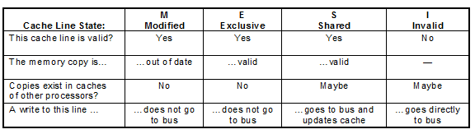
MESI Protocol
Any cache line / tag can be in one of 4 states (2 bits)
Invalid: It is a non-valid state.
Shared: Shared without having been modified. Another processor can have the data into the cache memory and both copies are in their current version.
Exclusive: Exclusive without having been modified. This cache is the only one that has the correct value of the block.
Modified: Exclusive-modified state. The cache has the only copy that is correct in the whole system. The data which are in the main memory are wrong.

Slide 82
MESI Protocol
Cache line changes state as a function of memory access events.
Event may be either
Due to local processor activity (i.e. cache access)
Due to bus activity - as a result of snooping
Cache line has its own state affected only if address matches

Slide 83
MESI Protocol
Operation can be described informally by looking at action in local processor
Read Hit
Read Miss
Write Hit
Write Miss
More formally by state transition diagram

Slide 84
MESI Local Read Hit
Line must be in one of MES
his must be correct local value (if M it must have been modified locally)
Simply return value
No state change

Slide 85
MESI Local Read Miss
No other copy in caches
Processor makes bus request to memory
Value read to local cache, marked E
One cache has E copy
Processor makes bus request to memory
Snooping cache puts copy value on the bus
Memory access is abandoned
Local processor caches value
Both lines set to S

Slide 86
MESI Local Read Miss
Several caches have S copy
Processor makes bus request to memory
One cache puts copy value on the bus (arbitrated)
Memory access is abandoned
Local processor caches value
Local copy set to S
Other copies remain S

Slide 87
MESI Local Read Miss
One cache has M copy
Processor makes bus request to memory
Snooping cache puts copy value on the bus
Memory access is abandoned
Local processor caches value
Local copy tagged S
Source (M) value copied back to memory
Source value M -> S

Slide 88
MESI Local Write Hit
Line must be one of MES
M
line is exclusive and already ‘dirty’
Update local cache value
no state change
E
Update local cache value
State E -> M

Slide 89
MESI Local Write Hit
S
Processor broadcasts an invalidate on bus
Snooping processors with S copy change S->I
Local cache value is updated
Local state change S->M

Slide 90
MESI Local Write Miss
Detailed action depends on copies in other processors
No other copies
Value read from memory to local cache
Value updated
Local copy state set to M

Slide 91
MESI Local Write Miss
Other copies, either one in state E or more in state S
Value read from memory to local cache - bus transaction marked RWITM (read with intent to modify)
Snooping processors see this and set their copy state to I
Local copy updated & state set to M

Slide 92
MESI Local Write Miss
Another copy in state M
Processor issues bus transaction marked RWITM
Snooping processor sees this
Blocks RWITM request
Takes control of bus
Writes back its copy to memory
Sets its copy state to I

Slide 93
MESI Local Write Miss
Another copy in state M (continued)
Original local processor re-issues RWITM request
Is now simple no-copy case
Value read from memory to local cache
Local copy value updated
Local copy state set to M

Slide 94
Putting it all together
All of this information can be described compactly using a state transition diagram
Diagram shows what happens to a cache line in a processor as a result of
memory accesses made by that processor (read hit/miss, write hit/miss)
memory accesses made by other processors that result in bus transactions observed by this snoopy cache (Mem read, RWITM,Invalidate)

Slide 95
MESI – locally initiated accesses
Read
Miss(sh)
Invalid
Shared
Read
Hit
Mem Read
Read
Miss(ex)
Invalidate
RWITM
Mem Read
Write
Hit
Write
Miss
Modified
Exclusive
Read
Hit
Read
Hit
Write
Hit
Write
Hit
= bus transaction

Slide 96
MESI – remotely initiated accesses
Mem Read
Invalid
Invalidate
Shared
Mem Read
RWITM
Mem Read
RWITM
Modified
Exclusive
= copy back

